Slide 1
Reinforcement Learning(RL) based Smart Offloading System

Slide 2
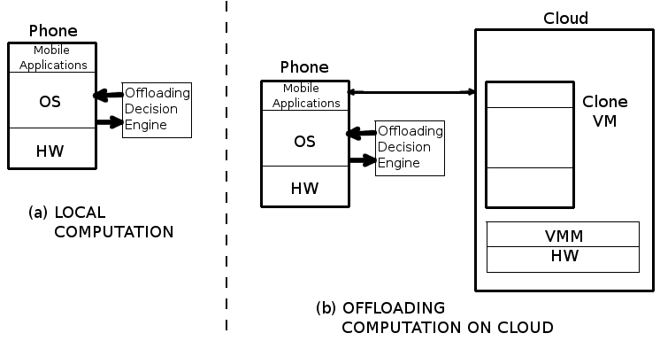
Code Offloading
Offloading Mobile computation on cloud is being widely considered for saving energy and increasing responsiveness of mobile devices. The potential of code offloading lies in the ability to sustain power hungry applications by identifying and managing energy consuming resources of the mobile device by offloading them onto cloud.

Slide 3
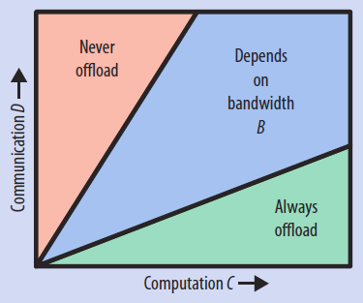
Code Offloading
The energy saved by computation offloading depends on the
wireless bandwidth B, the amount of computation to be performed C,
and the amount of data to be transmitted D.
Existing studies thus focus on determining whether to offload computation
by predicting the relationships among these three factors.
Offloading is beneficial when large amounts of computation C are needed
with relatively small amounts of communication D.

Slide 4
Applications that can benefit from Code Offloading
Compute Intensive Apps on Smartphones and other wearable computing devices like Google Glass and smart watches.
Applications using complex Machine Learning techniques such as Neural Network. Applications using Machine Learning have been unpopular among mobile devices due to the long training phase and need of high processing power.
An image retrieval application, Other Compute intensive Image Processing applications
Games such as Chess ( A chessboard has 8 × 8 = 64 positions. Each player controls 16 pieces at the beginning of the game. Chess is Markovian, meaning that the game is fully expressed by the current state. Each piece may be in one of the 64 possible locations and needs 6 bits to represent the location. To represent a chess game’s current state, it is sufficient to state that 6 bits × 32 pieces = 192 bits = 24 bytes; this is smaller than the size of a typical wireless packet. The amount of computation for chess is very large. )

Slide 5
Building Blocks of Offloading Architecture:
Code Profiler
The code profiler determines what to offload ?
It requires Code Partitioning, which means selection of the code to be offloaded (Method, Thread, or Class).
Code Profiler
Decision Engine
The decision engine analyzes the parameters from System and Code Profilers and applies certain logic over them to deduce when to offload ?
If the engine concludes a positive outcome, the offloading system is activated.
Decision Engine
System Profiler
System profiler monitor multiple parameters
of the smartphone, such as available bandwidth,
Data size to transmit, and energy to execute the code.
We look to these parameters to know
when to offload ? to the cloud.
System Profiler

Slide 6
Challenges in Code Offloading
The Offloading technique is far from being adopted in the design of current mobile architectures; this is because utilization of code offloading in real scenarios proves to be mostly negative.
Difficult to evaluate runtime properties of code, the code will have non-deterministic behavior during runtime, it is difficult to estimate the running cost of a piece of code considered for offloading
Code partitioning relies on the expertise of the software developer, the main idea is to annotate portions of code statically. These annotations can cause poor flexibility to execute the app in different mobile devices, it can cause unnecessary code offloading that drains energy.
The Offloading Decision engine in the mobile device should consider not only the potential energy savings, but also the response time of the request.

Slide 7
Contributions
We propose a novel, adaptive offloading technique called ‘Reward Based Offloading System’ that uses Reinforcement Learning (RL) and Fuzzy Logic to deduce right offloading decision. The decision is taken so that offloading is guaranteed to optimize both the response time and energy consumption.
We have studied Different techniques from the prior works that are proposed to empower Decision Engines with offloading logic for instance Fuzzy Logic Decision Engine, Decision Engine with SVR and other supervised Learning techniques
We evaluate our offloading technique with three real life example applications. During the evaluation, we run these applications under various situations (i.e. different locations, usage, and networks characteristics).
We have studied the viability of offloading solutions, with the help of benchmark applications to analyze right kind of applications which may benefit from effective Offloading Architecture.

Slide 8
Important Prior Works Studied
Adaptive code offloading for mobile cloud applications: Exploiting fuzzy sets and evidence-based learning [9]
Cuckoo: a computation offloading framework for smartphones [10]
Smartphone energizer: Extending smartphone's battery life with smart offloading [11]

Slide 9
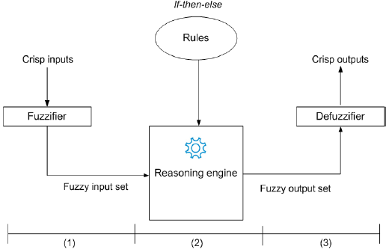
Fuzzy Logic Decision Engine
Fuzzy Logic Decision Engine works in three steps namely:
Fuzzycation, Inference and Defuzzication.

Slide 10
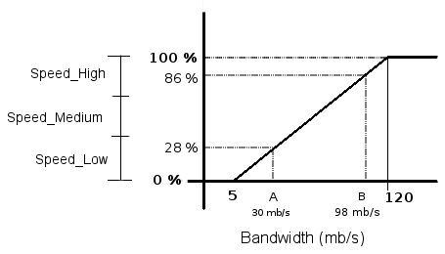
Fuzzy Logic Decision Engine
Fuzzy sets considered
Bandwidth = Speed Low, Speed Normal, Speed High
Data transferred = Data Small, Data Medium, Data Big
CPU instance = CPU Low, CPU Normal, CPU High
Wi-Fi = available, not available
Rules considered
Remote Processing = Speed High AND Data Small AND CPU Normal
Local Processing = Speed Low AND Data Small AND CPU High
Remote Processing = Speed Normal AND Data Small AND CPU High
Local Processing = Speed High AND Data Small AND CPU Low
Local Processing = Speed Low AND Data Medium AND CPU Normal
Offload on Local Servers = Remote Processing AND Wi-Fi ON
Offload on Remote Servers = Remote Processing AND Wi-Fi OFF

Slide 11
Reinforcement Learning
Reinforcement Learning (RL) is an approach where an RL agent learns by interacting with its environment and observing the results of these interactions. The idea is commonly known as “cause and effect”. So, RL is a form of unsupervised learning.
The reinforcement signal that the RL-agent receives is a numerical reward, which encodes the success of an actions outcome, and the agent seeks to learn to select actions that maximize the accumulated reward over time.
RL is being widely used for research in Robotics, Computer Games,
HCI, Controls, Economics etc.
RL problems are specified by a Markov Decision Process, which in some cases can be shown to be equivalent to a shortest-path problem but which are much more general. For instance, if you decide to take an action at some given state, the outcome is not necessarily deterministic, as most search algorithms assume, but stochastic.

Slide 12
Reinforcement Learning
Steps that RL-agent follows:
1. The agent observes an input state.
2. An action is determined by a decision making function (policy).
3. The action is performed.
4. The agent receives a scalar reward or reinforcement from the environment Information about the reward given for that state - action pair is recorded

Slide 13
Reward Based Offloading (How the proposed offloading system will work)
When the Mobile User opens an app, the offloading system will be activated with the
following sequence of steps:
Code Profiler
The code profiler will determine what to offload in this app?
(Method, Thread, or Class).
Code Profiler
Decision Engine
Decision Engine
The decision engine will apply fuzzy logic to these parameters provided by code and system profilers.
It will then use Reinforcement learning algorithms to determine right course of action for the user to get improved battery savings and Response Time.
System Profiler
System Profiler
System profiler will monitor parameters
of the smartphone such as available bandwidth,
User’s contextual information, Data size to transmit,
Wi-Fi connectivity.

Slide 14
Reward Based Offloading
State-Action Value Function
The state-action value function is a function of both state and action and its value is a prediction of the expected sum of future reinforcements.
State Values
Bandwidth = Speed Low, Speed Normal, Speed High
Wi-Fi = available, not available
Data transferred = Data Small, Data Medium, Data Big
CPU instance = CPU Low, CPU Normal, CPU High
This List of values that dene State can be extended. We can add other Parameters to the List as follows:
Location = Home, Office, Traveling
Time = Morning, Afternoon, Night
Action Values
We need to train our Q function in all above mentioned conditions. In each such instance our smartphone
will have three actions to choose from which are
Local Processing
Offload on Local Servers
Offload on Remote Servers

Slide 15
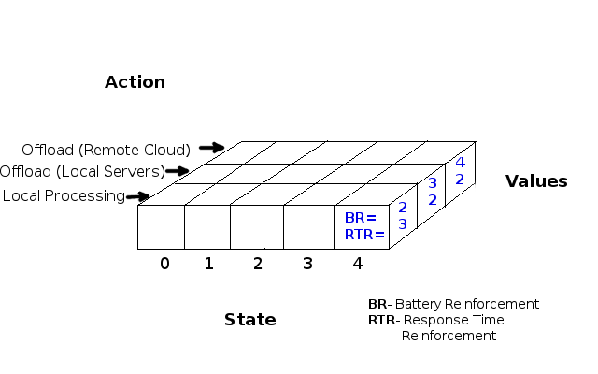
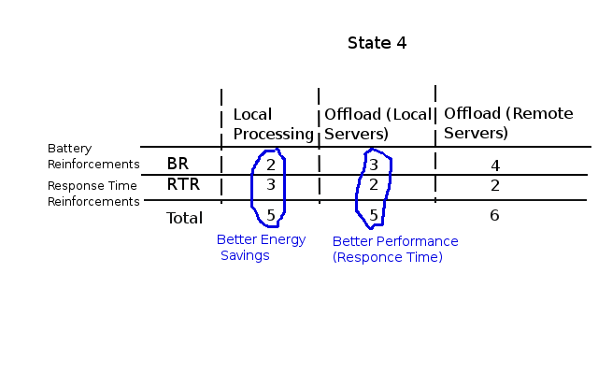
Assigning ‘Reinforcements’ to the State-Action pairs
Representing Q Table

Slide 16
Assigning ‘Key: Value’ pairs to update the Q table
Key 1
{ Location | Wi-Fi | CPU_Instance | Battery } Offload : Battery Reinforcement (BR)
Ex: { Home | yes | CPU_High | Battery } Offload : 3
Key : Value
Key 2
{ Location | Wi-Fi | CPU_Instance | ResponseTime} Offload : Response Time Reinforcement (RTR)
Ex: { Home | yes | CPU_High | ResponseTime} Offload : 2

Slide 17
Reward Based Offloading System- Algorithm 1 (Training Loop of Selected Smartphone apps)
Detect Change in the User Location (ex: Home, Office, Travelling)
Form a Key-Value Pair using the Parameters given by Code and System Profiler ( Bandwidth, Wi-Fi, Data to be transferred )
Check if the Key
(State-Action: pair) is present in the Q table
Yes
No
Explore the Actions which are never tried
Apply Fuzzy Logic to the State to get the right Action value
Perform the Action (Local Processing or Offload on Local Servers or Offload on Cloud)
Measure the Battery and Response Time Reinforcements and Update the Q Table

Slide 18
Reward Based Offloading System- Algorithm 2 (Slow Training Loop of Selected Smartphone apps)
When user opens an App on his Smartphone, the offloading system is consulted by the App first
Offloading Decision Engine Forms a Key-Value Pair using the Parameters given by Code and System Profiler ( Bandwidth, Wi-Fi, Data to be transferred )
Check if the Key
(State-Action: pair) is present in the Q table
Yes
No
Choose the Action with minimum Reinforcement Values (RBR, RTR)
Apply Fuzzy Logic to the State to get the right Action value
Perform the Action (Local Processing or Offload on Local Servers or Offload on Cloud)
Measure the Battery and Response Time Reinforcements and Update the Q Table

Slide 19
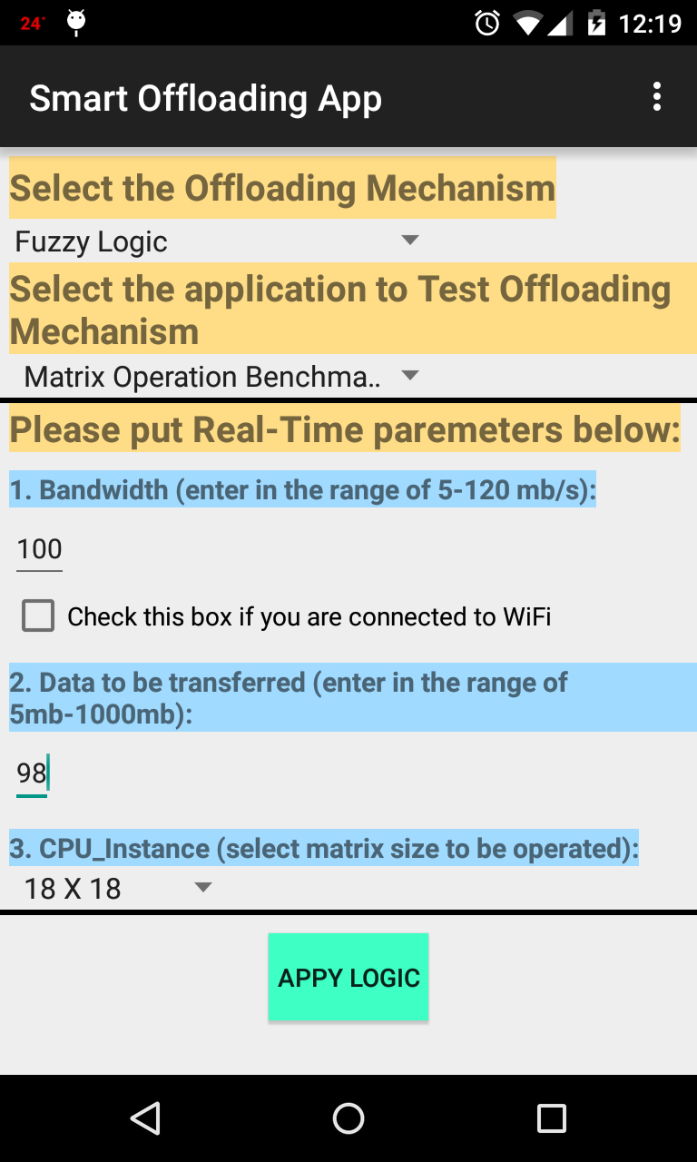
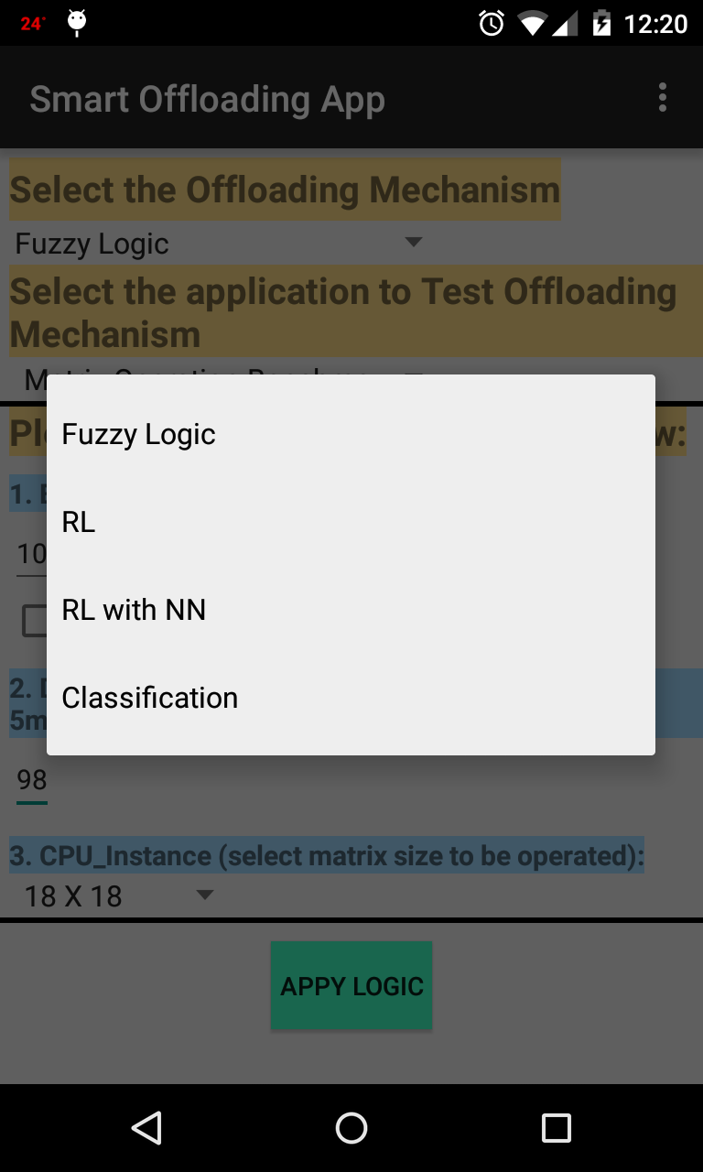
Implementation

Slide 20
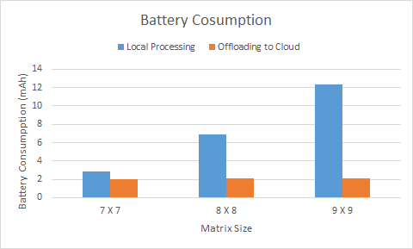
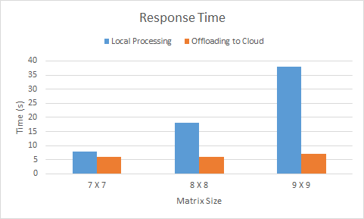
Experiments and Results
Battery Consumption and Response Time for Matrix Calculator App
performing Inverse of a Matrix

Slide 21
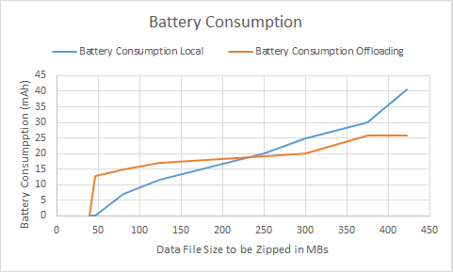
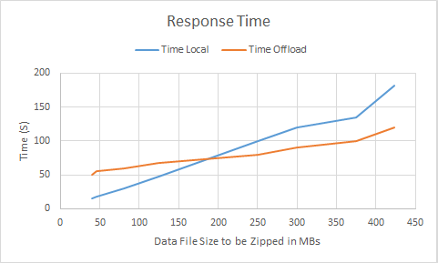
Experiments and Results
Battery Consumption and Response Time for Zipper App

Slide 22
Experiments and Results

Slide 23
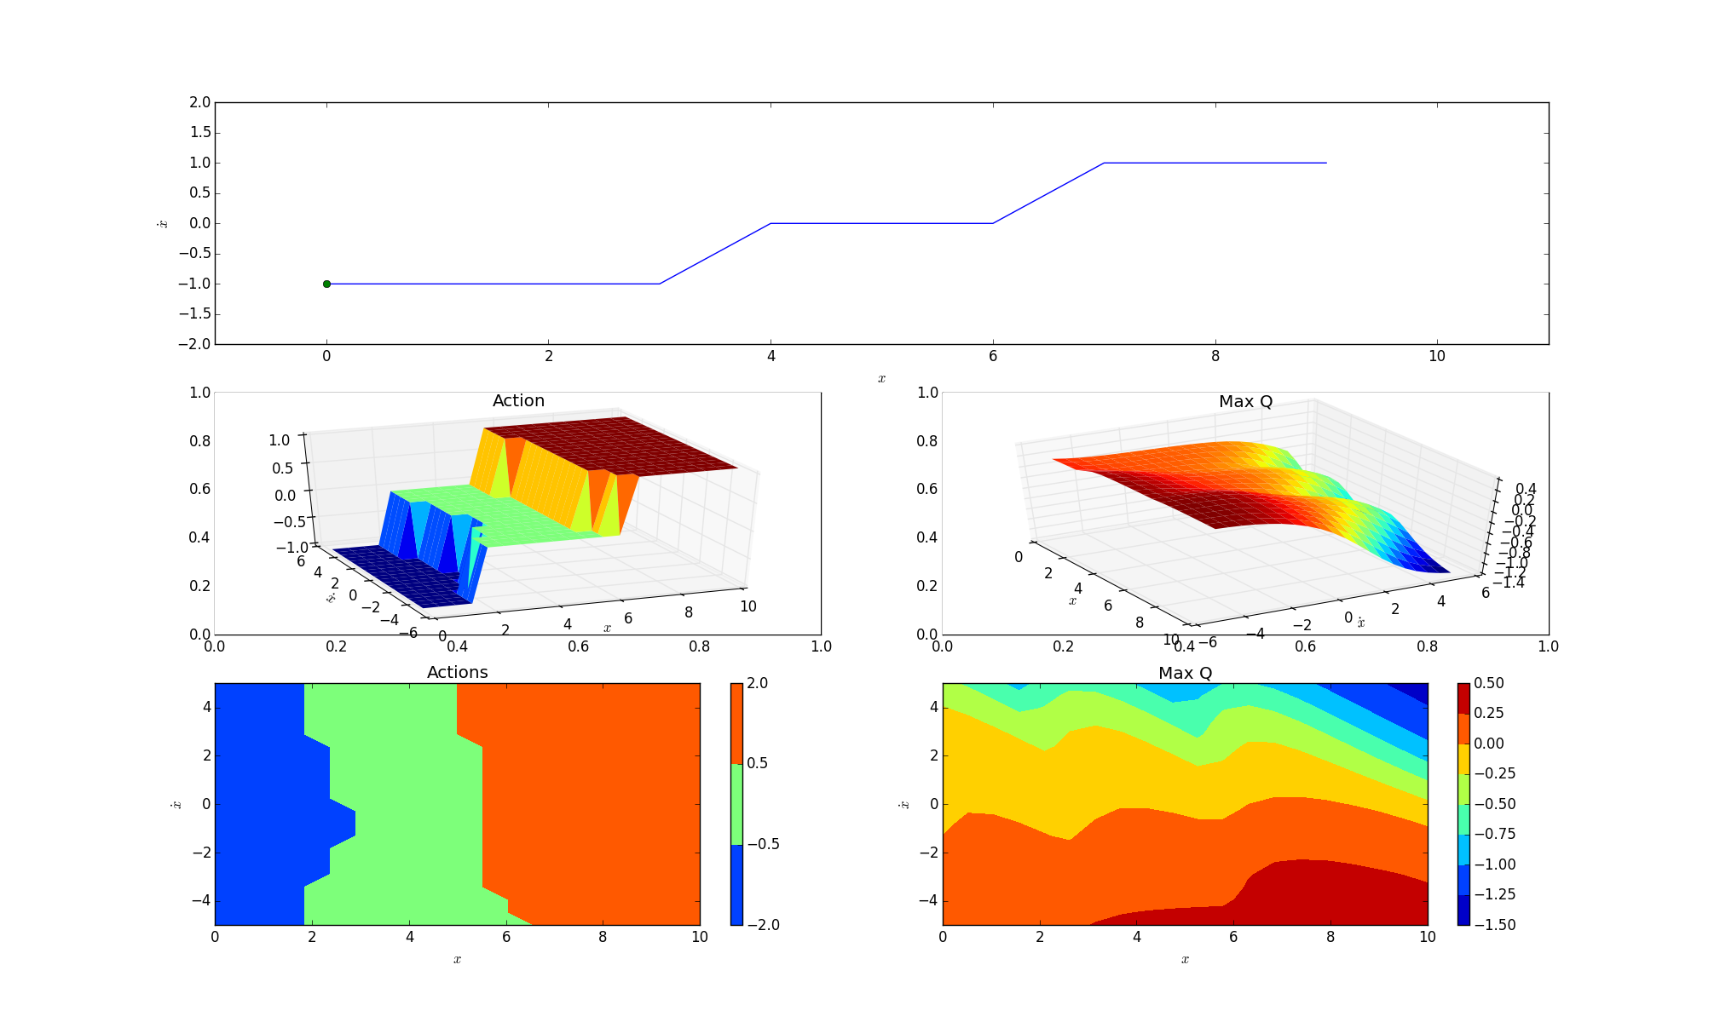
Experiments and Results
Reinforcement Learning with Neural Network

Slide 24
Advantages of our Reward based Offloading Model over other works
Improved Accuracy while predicting the right offloading decision
It’s a Novel Method with an Unsupervised Learning Model, so the Device can learn on its own while working in range of different geographical locations, and situations.
User has a choice to run the applications with option to select his preference between Better Energy Savings or Response Time, as our work takes into account both these factors.

Slide 25
Bibliography
[1] K. Kumar and Y.-H. Lu, \Cloud computing for mobile users: Can offloading computation save energy?," Computer, vol. 43, no. 4, pp. 51{56, 2010.
[2] H. Flores, P. Hui, S. Tarkoma, Y. Li, S. Srirama, and R. Buyya, “Mobile code offloading: from concept to practice and beyond,” Communications Magazine, IEEE, vol. 53, no. 3, pp. 80-88, 2015.
[3] E. Cuervo, A. Balasubramanian, D.-k. Cho, A. Wolman, S. Saroiu, R. Chandra, and P. Bahl, “Maui: making smartphones last longer with code offload,” in Proceedings of the 8th international conference on Mobile systems, applications, and services, pp. 49-62, ACM, 2010.
[4] B.-G. Chun, S. Ihm, P. Maniatis, M. Naik, and A. Patti, “Clonecloud: elastic execution between mobile device and cloud,” in Proceedings of the sixth conference on Computer systems, pp. 301-314, ACM, 2011.
[5] H. Flores and S. Srirama, “Mobile code offloading: should it be a local decision or global inference?,” in Proceeding of the 11th annual international conference on Mobile systems, applications, and services, pp. 539-540, ACM, 2013.
[6] S. Kosta, A. Aucinas, P. Hui, R. Mortier, and X. Zhang, “Thinkair: Dynamic resource allocation and parallel execution in the cloud for mobile code offloading,” in INFOCOM, 2012 Proceedings IEEE, pp. 945-953, IEEE, 2012.
[7] H. Flores, S. N. Srirama, and C. Paniagua, “A generic middleware framework for handling process intensive hybrid cloud services from mobiles,” in Proceedings of the 9th International Conference on Advances in Mobile Computing and Multimedia, pp. 87-94, ACM, 2011.
[8] H. R. Flores Macario and S. Srirama, “Adaptive code offloading for mobile cloud applications: Exploiting fuzzy sets and evidence-based learning,” in Proceeding of the fourth ACM workshop on Mobile cloud computing and services, pp. 9-16, ACM, 2013.
[9] R. Kemp, N. Palmer, T. Kielmann, and H. Bal, “Cuckoo: a computation offloading framework for smartphones,” in Mobile Computing, Applications, and Services, pp. 59-79, Springer, 2012.
[10] A. Khairy, H. H. Ammar, and R. Bahgat, “Smartphone energizer: Extending smartphone's battery life with smart offloading,” in Wireless Communications and Mobile Computing Conference (IWCMC), 2013 9th International, pp. 329-336, IEEE, 2013.

